Slide 1
Angular - Week 1 Agenda
Overview of web applications
HTML
CSS

Slide 2
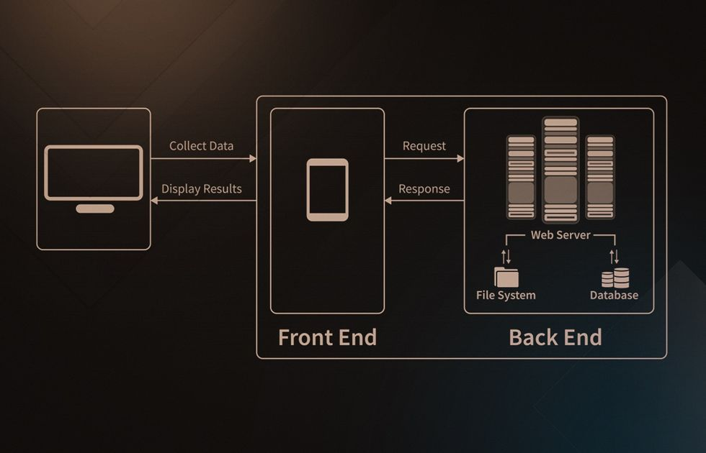
Understanding Web Application Architecture
A web application is a software application that runs on a web server and is accessed via a web browser over a network such as the Internet or an intranet.

Slide 3
Understanding Web Application Architecture
Key Components:
Client (Frontend): The user interface of the web application, typically built with HTML, CSS, and JavaScript. It runs on the user's web browser, allowing interaction with the application.
Server (Backend): The server hosts the application's logic and handles client requests. It is responsible for processing input from the frontend, interacting with databases or other services, and sending the appropriate responses back to the client.
Database: Stores, retrieves, and manages application data. It interacts directly with the backend server, enabling dynamic content generation based on user requests and actions.
Characteristics:
Interactive: Allows user interaction, updating content without the need to reload the entire page (e.g., through AJAX).
Stateless: Each request from client to server is treated independently, without necessarily knowing the previous requests.

Slide 4
How Client and Server Communicate in a Web Application
HTTP Requests: The client sends an HTTP request to the server, which can be triggered by various user actions such as clicking a link, submitting a form, or loading a webpage.
Processing Request: The server receives the request, processes it (which may involve querying the database), and generates an appropriate response. This response could be a webpage, data for updating part of a page, or an error message
Response and Rendering: The server sends the response back to the client. The browser then interprets the response and renders it for the user. For dynamic content, JavaScript may be used to update the UI without reloading the page.

Slide 5
HTML
HTML, or HyperText Markup Language, is the standard markup language used in the creation of web pages. It forms the backbone of any website and is essential for creating and visually representing a webpage.
Element Structure: HTML is made up of elements, which are the building blocks of any webpage. An element includes opening and closing tags, with content in between. For example, <p> is an opening tag and </p> is a closing tag, with any text in between constituting a paragraph.
Semantic Elements: HTML5 introduced semantic elements which provide meaning to both the browser and the developer. They make the code easier to read and understand. Examples include <header>, <footer>, <article>, and <section>.
Attributes: Elements can have attributes that provide extra information about the element. They come in name/value pairs like: name="value". For instance, the href attribute in <a href="https://example.com"> specifies the link's destination.
Forms: HTML allows for the creation of forms to collect user input. Elements like <input>, <textarea>, and <select> are used to create these input fields.

Slide 6
HTML
Multimedia: HTML supports multimedia elements such as images, audio, and video. For instance, the <img> tag is used to embed an image in a webpage, while <audio> and <video> tags are used for audio and video content respectively.
Links and Navigation: HTML uses the <a> tag to create hyperlinks, allowing for navigation between different pages or sections within a page.
CSS Integration: HTML is often used in conjunction with CSS (Cascading Style Sheets), which is used for styling and layout of webpages. CSS styles can be included inline with the style attribute, embedded in the head section of an HTML document, or linked externally using the <link> element.
Scripting: HTML documents can include scripts, typically JavaScript, to add interactivity and dynamic content. These scripts can be embedded in the HTML document or linked externally.
Doctype Declaration: Every HTML document begins with a document type declaration, <!DOCTYPE html>. This is used to tell the web browser about the version of HTML the page is written in.Standardized and Open: HTML is a standardized language and is maintained by the World Wide Web Consortium (W3C). It is open and free

Slide 7
HTML Elements
Heading: HTML provides six levels of headings, from <h1> to <h6>. <h1> is the highest level of heading, often used for main titles, while <h6> is the lowest level, often used for subheadings.
<h1>This is a Heading</h1><h2>This is a sub-heading</h2>
Table: An HTML table is defined with the<table>tag. Each table row is defined with the<tr>tag, and a table cell is defined with the<td>tag. The<th>tag is used to create table headers.
<table><tr><th>Firstname</th><th>Lastname</th></tr><tr><td>John</td><td>Doe</td></tr></table>
Button: The<button>tag defines a clickable button. Inside the element, you can place text or images
<button>Click me</button>
Paragraph: The<p>tag is used to define a paragraph. Browsers automatically add some space (margin) before and after each<p>element
<p>This is a paragraph.</p><p>This is another paragraph.</p>
Links: The<a>tag is used to create a hyperlink, which can be clicked to navigate to another webpage or a different section of the same webpage. Thehref attribute is used to specify the URL of the page the link goes to.
<a href="https://example.com">This is a link</a>
Input: The<input>element is used to create interactive controls for web-based forms in order to accept data from the user. There are many types of input, like text, email, password, etc. Thetypeattribute determines what kind of input field to display.
<form> Name: <input type="text" name="name"><br>Email: <input type="email" name="email"></form>

Slide 8
CSS
CSS: Cascading Style Sheets, a style sheet language used for describing the look and formatting of a document written in HTML.
Syntax: CSS is made up of selectors (to select HTML elements) and a declaration block (contains properties and values). E.g., h1 {color: red;}.
Selectors: Element, ID, Class, and Attribute selectors are used to apply styles to specific HTML elements.

Slide 9
Styling HTML Elements
Text and Background Colors: The 'color' property styles text color, and 'background-color' sets the color behind an element.
Fonts: The 'font-family' property sets the typeface, 'font-size' sets the size of the text.
Box Model: Every element in CSS is a box, consisting of margins, borders, padding, and the actual content. 'Margin' controls the space around elements, 'padding' is the space between the element content and its border, and 'border' is the line that goes around padding and content.
Width and Height: These properties allow you to set the width and height of an element.

Slide 10
CSS Positioning and Layouts
Display: The 'display' property defines how an element should be displayed. Common values are 'block', 'inline', 'inline-block', and 'none'.
Colors: Colors in CSS can be specified by the name (e.g., "blue"), a hexadecimal value (e.g., "#ff0000"), or even using RGB, RGBA, or HSL values (e.g., "rgb(255,0,0)").
Summary: CSS is a powerful tool that controls the layout and appearance of HTML elements on a web page. It offers great flexibility and control, enhancing the user's browsing experience.

